Slide 1
Chapter 5: Process Synchronization
Background
The Critical-Section Problem
Mutex Locks
Semaphores
Classic Problems of Synchronization

Slide 2
Background
Processes can execute concurrently
May be interrupted at any time, partially completing execution
Concurrent access to shared data may result in data inconsistency
Maintaining data consistency requires mechanisms to ensure the orderly execution of cooperating processes

Slide 3
Race Condition
counter++ could be implemented as register1 = counter register1 = register1 + 1 counter = register1
counter-- could be implemented as register2 = counter register2 = register2 - 1 counter = register2
Consider this execution interleaving with “count = 5” initially:
S0: producer execute register1 = counter {register1 = 5} S1: producer execute register1 = register1 + 1 {register1 = 6} S2: consumer execute register2 = counter {register2 = 5} S3: consumer execute register2 = register2 – 1 {register2 = 4} S4: producer execute counter = register1 {counter = 6 } S5: consumer execute counter = register2 {counter = 4}

Slide 4
Critical Section Problem
Consider system of n processes {p₀, p₁, … p_{n-1}}
Each process has critical section segment of code
Process may be changing common variables, updating table, writing file, etc
When one process in critical section, no other may be in its critical section
Critical section problem is to design protocol to solve this
Each process must ask permission to enter critical section in entry section, may follow critical section with exit section, then remainder section

Slide 5
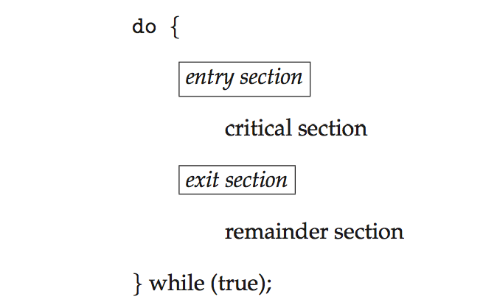
Critical Section
General structure of process P_{i}

Slide 6
Mutual Exclusion Locks
Previous solutions are complicated and generally inaccessible to application programmers
OS designers build software tools to solve critical section problem
Simplest is mutex lock
Protect a critical section by first acquire() a lock then release() the lock
Boolean variable indicating if lock is available or not
Calls to acquire() and release() must be atomic
Usually implemented via hardware atomic instructions
But this solution requires busy waiting
This lock therefore called a spinlock

Slide 7
acquire() and release()
acquire() { while (!available); /* busy wait */
available = false;
}
release() {
available = true;
}
do {
acquire lock
critical section
release lock
remainder section
} while (true);

Slide 8
Lab Practice: lab2.c extension (lab2_ex.c)
Add the ‘sum’ operation into the created thread, and make it as a critical section
printf("thread_arg = %d was created\t", arg);
sum = 0;
for(int i=0; i<=arg; i++)
sum += i;
printf("sum = %d\n", sum);
//printf("and sleeping for 60 secs\n");
Expected Output after Mutual Exclusion:
jurn@ZBookG4:~/work/cs332/thread$ thread number = 10
thread_arg = 0 was created sum = 0 //(must be atomic operation, and the results always MUST be corrent)
thread_arg = 1 was created sum = 1 //(0+1)
thread_arg = 3 was created sum = 6 //(0+1+2+3)
thread_arg = 2 was created sum = 3 //(0+1+2)
thread_arg = 4 was created sum = 10 ...
thread_arg = 5 was created sum = 15
thread_arg = 6 was created sum = 21
thread_arg = 7 was created sum = 28
thread_arg = 9 was created sum = 45
thread_arg = 8 was created sum = 36

Slide 9
Programming details
#include <pthread.h>
pthread_spinlock_t slock;
pthread_spin_init( &slock, 0);
// 2nd argument (int pshared): it must have one of the two
PTHREAD_PROCESS_PRIVATE (0: Default)
The spin lock is to be operated on only by threads in the same
process
PTHREAD_PROCESS_SHARED
The spin lock may be operated on by any thread in any process
pthread_spin_lock( &slock );
pthread_spin_unlock( &slock );

Slide 10
Semaphore
Synchronization tool that provides more sophisticated ways (than Mutex locks) for processes/threads to synchronize their activities.
Semaphore S – integer variable
Can only be accessed via two indivisible (atomic) operations
wait() and signal()
Originally called P() and V()
Definition of the wait() operation
wait(S) {
while (S <= 0); // busy wait
S--;
}
Definition of the signal() operation
signal(S) {
S++;
}

Slide 11
Semaphore Usage
Counting semaphore – integer value can range over an unrestricted domain
Binary semaphore – integer value can range only between 0 and 1
Same as a mutex lock
Can solve various synchronization problems
Consider P₁ and P₂ that require S₁ to happen before S₂
Create a semaphore “synch” initialized to 0
P1:
S₁;
signal(synch);
P2:
wait(synch);
S₂;
Can implement a counting semaphore S as a binary semaphore

Slide 12
Semaphore Implementation with no Busy waiting
With each semaphore there is an associated waiting queue
Each entry in a waiting queue has two data items:
value (of type integer)
pointer to next record in the list
Two operations:
block – place the process invoking the operation on the appropriate waiting queue
wakeup – remove one of processes in the waiting queue and place it in the ready queue
typedef struct{
int value;
struct process *list;
} semaphore;

Slide 13
Implementation with no Busy waiting (Cont.)
wait(semaphore *S) {
S->value--;
if (S->value < 0) { add this process to S->list;
block();
}
}
signal(semaphore *S) {
S->value++;
if (S->value <= 0) { remove a process P from S->list;
wakeup(P);
}
}

Slide 14
Classical Problems of Synchronization
Classical problems used to test newly-proposed synchronization schemes
Bounded-Buffer Problem
Readers and Writers Problem
Dining-Philosophers Problem

Slide 15
Producer
while (true) { /* produce an item in next produced */
while (counter == BUFFER_SIZE) ;
/* do nothing */
buffer[in] = next_produced;
in = (in + 1) % BUFFER_SIZE;
counter++;
}

Slide 16
Consumer
while (true) {
while (counter == 0)
; /* do nothing */
next_consumed = buffer[out];
out = (out + 1) % BUFFER_SIZE;
counter--;
/* consume the item in next consumed */
}

Slide 17
Bounded-Buffer Problem
n buffers, each can hold one item
Semaphore mutex initialized to the value 1
Semaphore full initialized to the value 0
Semaphore empty initialized to the value n

Slide 18
Bounded Buffer Problem (Cont.)
The structure of the producer process
do {
... /* produce an item in next_produced */
...
wait(empty);
wait(mutex);
... /* add next produced to the buffer */
...
signal(mutex);
signal(full);
} while (true);

Slide 19
Bounded Buffer Problem (Cont.)
The structure of the consumer process
Do {
wait(full);
wait(mutex);
... /* remove an item from buffer to next_consumed */
...
signal(mutex);
signal(empty);
... /* consume the item in next consumed */
... } while (true);

Slide 20
Readers-Writers Problem
A data set is shared among a number of concurrent processes
Readers – only read the data set; they do not perform any updates
Writers – can both read and write
Problem – allow multiple readers to read at the same time
Only one single writer can access the shared data at the same time
Several variations of how readers and writers are considered – all involve some form of priorities
Shared Data
Data set
Semaphore rw_mutex initialized to 1
Semaphore mutex initialized to 1
Integer read_count initialized to 0

Slide 21
Readers-Writers Problem (Cont.)
The structure of a writer process
do { wait(rw_mutex);
... /* writing is performed */
...
signal(rw_mutex);
} while (true);

Slide 22
Readers-Writers Problem (Cont.)
The structure of a reader process
do { wait(mutex); read_count++; if (read_count == 1)
wait(rw_mutex);
signal(mutex);
... /* reading is performed */
...
wait(mutex); read count--; if (read_count == 0)
signal(rw_mutex);
signal(mutex);
} while (true);

Slide 23
Readers-Writers Problem Variations
First variation – no reader kept waiting unless writer has permission to use shared object
Second variation – once writer is ready, it performs the write ASAP
Both may have starvation leading to even more variations
Problem is solved on some systems by kernel providing reader-writer locks

Slide 24
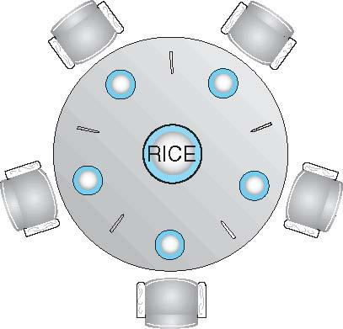
Dining-Philosophers Problem
Philosophers spend their lives alternating thinking and eating
Don’t interact with their neighbors, occasionally try to pick up 2 chopsticks (one at a time) to eat from bowl
Need both to eat, then release both when done
In the case of 5 philosophers
Shared data
Bowl of rice (data set)
Semaphore chopstick [5] initialized to 1

Slide 25
Dining-Philosophers Problem Algorithm
The structure of Philosopher i:
do {
wait (chopstick[i] );
wait (chopStick[ (i + 1) % 5] );
// eat
signal (chopstick[i] );
signal (chopstick[ (i + 1) % 5] );
// think
} while (TRUE);
What is the problem with this algorithm?

Slide 26
Dining-Philosophers Problem Algorithm (Cont.)
Deadlock handling
Allow at most 4 philosophers to be sitting simultaneously at the table.
Allow a philosopher to pick up the forks only if both are available (picking must be done in a critical section.
Use an asymmetric solution -- an odd-numbered philosopher picks up first the left chopstick and then the right chopstick. Even-numbered philosopher picks up first the right chopstick and then the left chopstick.

Slide 27
Problems with Semaphores
Incorrect use of semaphore operations:
signal (mutex) …. wait (mutex)
wait (mutex) … wait (mutex)
Omitting of wait (mutex) or signal (mutex) (or both)
Deadlock and starvation are possible.

